Slide 1


Slide 2
Parallelism on Ranges: Should We?
When expressive code meets performance
Giannis Gonidelis (gonidelis[at]ece.auth.gr)
Notes:
BLA hates double titles.

Slide 3


Who’s Giannis
ECE undergraduate from Greece
STE||AR GROUP member
Active Open-Source Contributor at HPX
Currently working on adapting C++ Parallel Algorithms to C++20
STE||AR GROUP

Slide 4

What’s STE||AR Group
Research Group led by Hartmut Kaiser @ CCT - LSU
HPX: A C++ Standards Library for Concurrency and Parallelism
Phylanx: An Asynchronous Distributed Array Computing Toolkit
STE||AR GROUP

Slide 5
ALGORITHMS AND RANGES
01
HPX
02
TABLE OF CONTENTS
PARALLEL RANGES
03
RESULTS
04
FUTURE WORK
05
From STL to Parallelism TS to range-v3
A C++ Standards library you mostly need but never heard of
The hows, whys and what ifs on imposing parallelism to ranges
Benchmarking and evaluating the results
Further challenges and what to expect
STE||AR GROUP

Slide 6
01. Algorithms and Ranges
STE||AR GROUP

Slide 7
In the beginning was the STL...
std::vector<int> v{ 1, 2, 3, 4};
std::find(begin(v), end(v), 3);
Containers
Class templates for data structure implementation like arrays, vectors, stacks etc.
Iterators
Pointer-like objects that refer to elements in the containers
Algorithms
Basic, out of the box, standardized algorithms
STE||AR GROUP

Slide 8
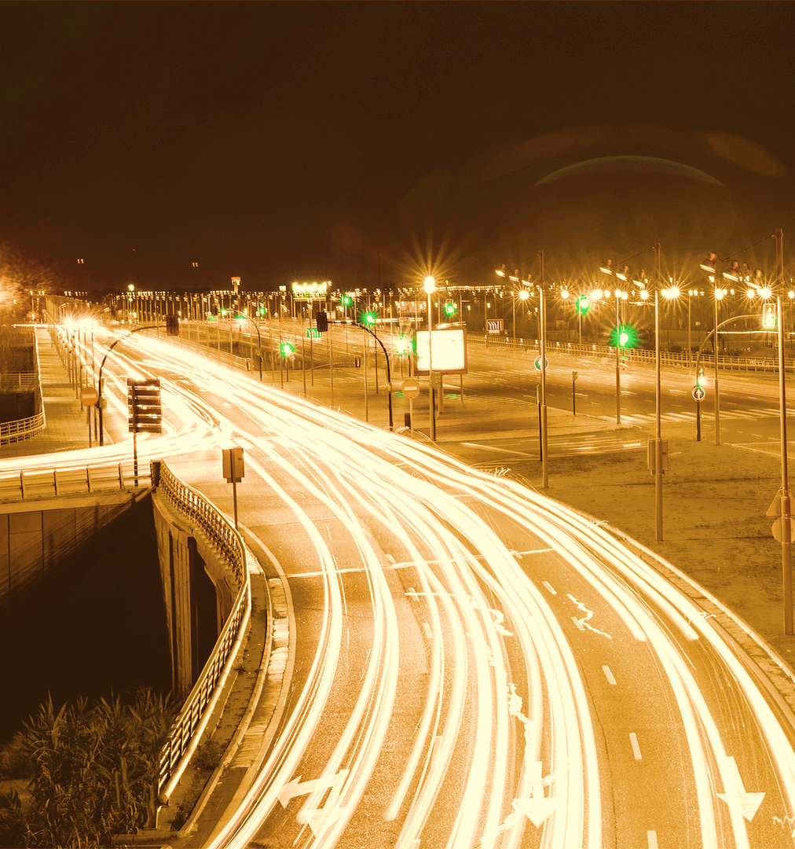
Parallelism TS
“C++17 ships and the concepts of execution policies are introduced. The standard now, officially supports parallelism and the STL algorithms could finally be performant!”

Slide 9
Execution Policies
The user can now define the way their algorithm wants to run:
Sequenced Execution policy (seq)
Parallel Execution policy (par)
Vectorization Execution policy (unseq)
Parallel Vector Execution policy (par_unseq)
Asynchronous Execution policy
STE||AR GROUP

Slide 10
New Parallel - Overloads
std::vector<int> v{ 1, 2, 3, 4};
std::find(begin(v), end(v), 3);
Just one argument
Let the compiler/library manage parallelization
Readability
Let the compiler/library manage parallelization
std::vector<int> v{ 1, 2, 3, 4};
std::find(par, begin(v), end(v), 3);
STE||AR GROUP

Slide 11
Until C++20
We didn’t have
STL
Composability
Out of the box algorithms and data structures
Coding multiple sequencies is still inconvenient
Performance(?)
We had
Performant Composability
Simple execution policy overloads that automatically parallelize our sequencies
Immediate effect of lack of composability
STE||AR GROUP

Slide 12
A wild range-v3 appears
<
Composability
Expressiveness (readability)
Performance Potential
Multiple algorithmic operations can now easily be composed
Code becomes both more intuitive and readable
Chained operations are fused and become scalable
STE||AR GROUP

Slide 13

A range is:
an abstraction of “a sequence of items”
something iterable
A range actually is:
A begin iterator/sentinel pair, where sentinel:
an end iterator of same type as begin iterator
a value
a distance from begin
STE||AR GROUP

Slide 14
Range-v3
range
begin iterator
end iterator
h | e | l | l | o | \0
c_string
also range!
+2
also range
STE||AR GROUP

Slide 15
Range-v3: Expressiveness
std::vector<int> v{ 1, 2, 3, 4};
std::find(begin(v), end(v), 3);
Iterator free!
Intuitive for simple use cases
Readable
std::vector<int> v{ 1, 2, 3, 4};
ranges::find(v, 3);
STE||AR GROUP

Slide 16

Range-v3: Expressiveness
Sentinels
Not only can we skip the end iterator being the same type, but we can also explicitly define the end of the range with a value.
std::vector<int> v{ 1, 2, 3, 4, 5};
std::find(begin(v), end(v), 4);
giannis@eniac:~$ output: 3
std::vector<int> v{ 1, 2, 3, 4, 5};
ranges::find(begin(v), sentinel<int>{4}, 3);
STE||AR GROUP

Slide 17
Range-v3:
Composability
std::vector<int> vi{ 1, 2, 3, 4, 5};
std::transform(vi.begin(), vi.end(), vi.begin(), [](int i) {return i * i;});
auto res = std::remove_if(vi.begin(), vi.end(), [](int i) {return i % 2 == 1;});
std::vector<int> vi{ 1, 2, 3, 4, 5};
auto rng = vi |
ranges::views::transform([](int i){return i * i;}) |
ranges::views::remove_if([](int i){return i % 2 == 1;});
giannis@eniac:~$out: [4,16]
STE||AR GROUP

Slide 18
Range-v3: Composability
1. std::vector<int> vi{ 1, 2, 3, 4, 5};
2.
3. auto rng = vi |
4. ranges::views::transform([](int i){return i*i;}) |
5. ranges::views::remove_if([](int i){return i % 2 == 1;});
6.
7. std::cout << rng;
Here is where
rng evaluation is initiated
views: lazy algorithms that are evaluated on demand
range adaptors: take a range as an input and return a view
pipe “Bash-like” operator `|` composes range adaptors
STE||AR GROUP

Slide 19

In C++20
STL
We don’t have
Out of the box algorithms and data structures
Composability
Coding multiple sequencies is still inconvenient
We have
Performance
Simple execution policy overloads that automatically parallelize our sequencies
Performant Composability
Immediate effect of lack of composability
STE||AR GROUP

Slide 20
02. HPX
STE||AR GROUP

Slide 21
STANDARDS CONFORMING
GENERAL PURPOSE LIBRARY
PARALLELISM
ASYNCHRONY
Standards oriented API
Just change your namespace from std:: → hpx:: and everything works!
Is aimed towards any kind of application, from local parallelization projects to big-time distributed astrophysics experiments
C++ Standards
Library
for Concurrency and Parallelism
Full Auto-parallelization
Optimal workload distribution
Wide set of STL parallel algorithms available
“Hardcore” futurization removes execution barriers imposed by widely adopted parallel models
STE||AR GROUP

Slide 22

OUR EXECUTION MODEL
GRAIN SIZE
THREAD MANAGEMENT
Why restrain our execution models to static grain sizes?
Why not take advantage of idle threads?
Reallocate work on the fly
Always keep them threads busy
STE||AR GROUP

Slide 23
Dynamic Thread Allocation
Your everyday parallel runtime system
HPX
Core 1
Idle
Core 2
Idle
Core 3
Idle
Idle
Idle
Core 4
Idle
Idle
Idle
Barriers are bad!
More work done in smaller time frame
STE||AR GROUP

Slide 24
HPX Execution Policies
The user can now define the way their algorithm wants to run:
Sequential Execution policy (seq)
Parallel Execution policy (par)
Vector Execution Policy (unseq)
Parallel Vector Execution policy (par_unseq)
Asynchronous Execution policy
Just one argument
Readability
Full control over your parallelization
Let the compiler manage parallelization
(par(task))
STE||AR GROUP

Slide 25
FUTURIZE EVERYTHING
Do things…
// Maybe call an algo
transform(w.begin(),
w.end(), ...);
…waiting!
// or play with rang-v3
int sum = accumulate(
views::ints(1));
…without...
std::list
<int> l(10);
Initiate Work
Get Result
future<int> f = async(&fun);
// or
future<void> f = for_each(par(task),
v.begin(), v.end(), /*do_lambda*/);
f.get();
/* or attach
continuation */
f.then(
/*do next thing*/);
STE||AR GROUP

Slide 26

HPX IS ALL ABOUT
Standards
Asynchrony
Algorithms
STE||AR GROUP

Slide 27
HPX Algorithms Support
All C++ Standard Parallel Algorithms
With additional asynchronous Ex. Policies
Ranges Overloads (ongoing)
PAR
ASYNC
RANGES
hpx
std::reduce(par,
v.cbegin(), v.cend());
std
hpx::ranges::reduce(v); //or
hpx::ranges::reduce(
v.begin(), sentinel);
hpx::reduce(par(task),
v.cbegin(), v.cend());
STE||AR GROUP

Slide 28
In C++20 with HPX
STL
We don’t have
Out of the box algorithms and data structures
Composability
Performant Composability
Coding multiple sequencies is still inconvenient
Immediate effect of lack of composability
Performance
(?)
We have
!
Both concurrent and asynchronous parallelism with large scaling support for millions of threads
Simple execution policy overloads that automatically parallelize our sequencies
STE||AR GROUP

Slide 29
03. PARALLEL RANGES
STE||AR GROUP

Slide 30
Stage 0
Simple ranges APIs – No Execution Policy
hpx::ranges::reduce(v)
C++20 Conformance
hpx::ranges::reduce(
v.begin(), sentinel)
STE||AR GROUP

Slide 31
Stage 1
hpx::for_each(par, v.begin(), v.end(), /*do_lambda*/);
Base implementation handles iterators of same type as input. Easy.
namespace hpx { namespace ranges {
result_type for_each(ExPolicy policy, Rng rng, F f)
{
return for_each(policy, hpx::util::begin(rng), hpx::util::end(rng), f);
}
}}
base implementation
STE||AR GROUP

Slide 32
Stage 1.5
Enable the base implementation to accept different types for begin - end.
namespace hpx { namespace ranges {
result_type for_each(ExPolicy policy, Iter iter, Sent sent, F f)
{
return base_impl::for_each(policy, iter, sent, f);
}
}}
ranges::next()
ranges::advance()
Create an end iterator by the sentinel, using ranges facilities (advance, distance, next etc.).
…
new_end_iter
 |  |  |  |  |  |  |  |  |  |  |  |  |  | S
STE||AR GROUP
Notes:
SIMPLE API-DISPATCHING PROBL
we guarantee that if sentinel is proper then it works: the properties for our geeky friends are “…”
RNG <- vector, whatever_packaged_from_the_user_container

Slide 33
So far…
Parallelize
when input is
iterator – sentinel pair
Parallelize when input is a single <Rng> argument
C++20 Conformance
STE||AR GROUP

Slide 34
Stage 2 – Final goal
Could we parallelize a sequence like the following?
It’s does not look like a concrete range
How?
1. std::vector<int> vi{ 1, 2, 3, 4, 5};
2.
3. auto rng = vi |
4. ranges::views::transform([](int i){return i * i;}) |
5. ranges::views::remove_if([](int i){return i % 2 == 1;});
There are no STL C++ algorithms involved
It’s not even a single operation
STE||AR GROUP

Slide 35
Stage 2 – Final goal
Provide combined algorithmic implementations dedicated to each combination of two, three etc. views – operations.
Hundreds or thousands of combinations.
replace
sort
group_by
fill
transform
generate
remove_if
find
copy
iota
binary_search
STE||AR GROUP
Notes:
JUST KEEP THE VIEWS SET

Slide 36
Stage 2 – Final goal
Provide combined algorithmic implementations dedicated to each combination of two, three etc. views – operations.
Hundreds or thousands of combinations.
transform()
Isolate and parallelize each single operation in a fork-join mode.
Barriers are bad.
remove_if()
Fuse the multiple sequencies on an element-by-element basis and parallelize it.
STE||AR GROUP
Notes:
JUST KEEP THE VIEWS SET

Slide 37
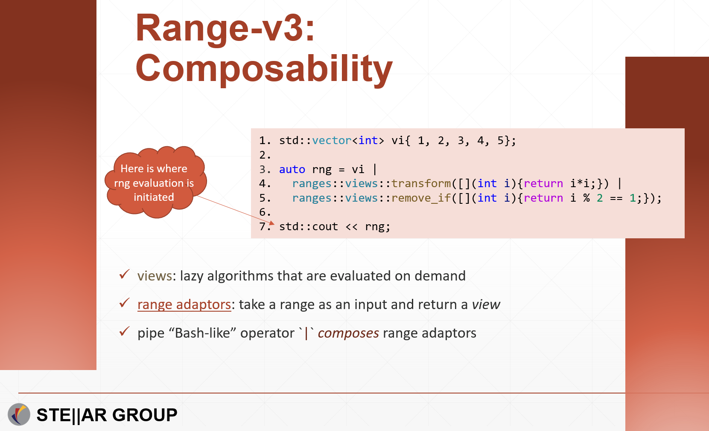
A. Inherent Fusion
vi | ranges::views::transform() | ranges::views::remove_if()
1
1
4
7
2
6
0
2
9
transform
remove_if
0
STE||AR GROUP

Slide 38
A. Inherent Fusion
vi | ranges::views::transform() | ranges::views::remove_if()
1
1
4
7
2
6
0
2
9
transform
remove_if
0
STE||AR GROUP
transform and remove_if

Slide 39
A. Inherent Fusion
vi | ranges::views::transform() | ranges::views::remove_if()
1
transform
and then
remove_if
Range view pipe operator inherently fuses the operations in an element-by-element basis
1
4
7
2
6
0
2
9
Could be parallelized as a single operation
0
STE||AR GROUP

Slide 40
A. Inherent Fusion
1. std::vector<int> vi{ 1, 2, 3, 4, 5};
2.
3. auto rng = vi |
4. ranges::views::transform([](int i){return i * i;}) |
5. ranges::views::remove_if([](int i){return i % 2 == 1;});
6.
7. ranges::for_each(rng, [](auto i){return i;});
“Should we parallelize it though?”
Port sequence in an algorithm to enable fused composition on an element-by-element basis
STE||AR GROUP
Notes:
THE MOST IMPORTANS: Why not have the benefits of HPX on top of range-v3?

Slide 41
B. Hard vs Easy to Parallelize combinations
Easy
transform
remove_if
transform
reverse
Hard
adjacent_remove_if
reverse
accumulate
transform
It highly depends on the iterator type exposed by the chained views (non-trivial) → random access iterators are the best!
Temporaries, container conditional resizing and predicates related to multiple elements of the container make parallelization difficult
STE||AR GROUP

Slide 42
HPX/Range-v3
std::vector<int> vi(10'000'000);
std::iota(vi.begin(), vi.end(), 1);
auto rng = vi | ranges::views::transform([](int i){return i*i;})
| ranges::views::reverse;
hpx::ranges::for_each(hpx::execution::par, rng, [](auto i){return i;});
It runs in parallel just fine!
Take advantage of the fused composition in order to parallelize range materialization
STE||AR GROUP
Notes:
Yes it works out of the box.
It would probably also work on std parallel algos but:
1. nobody has made remarks on that
2. there is no API support

Slide 43
Parallelize when input
is composed from a
chain of views
Parallelize
when
iterator – sentinel input
Parallelize when single Rng argument input
C++20 Conformance
STE||AR GROUP

Slide 44
HPX/Ranges benefits
MERCURY
MARS
Futurization and asynchrony
Dedication to performance
Standard
C++
VENUS
SATURN
Composability
STE||AR GROUP

Slide 45
In HPX with Range-v3
STL
We don’t have
Out of the box algorithms and data structures
Composability
Performant Composability
Coding multiple sequencies is still inconvenient
Performance!
Immediate effect of lack of composability
We have
Both concurrent and asynchronous parallelism with large scaling support for millions of threads
STE||AR GROUP

Slide 46
04. RESULTS
STE||AR GROUP

Slide 47
A bad case
std::vector<int> vi(100'000'000);
std::iota(vi.begin(), vi.end(), 1);
3.
4. auto rng = vi |
5. ranges::views::transform([](int i){return i * i;}) |
6. ranges::views::remove_if([](int i){return i % 2 == 1;});
7.
8.hpx::ranges::for_each(hpx::execution::par, rng, [](auto i){return i;});
STE||AR GROUP

Slide 48
A good case
std::vector<int> vi(100'000'000);
std::iota(vi.begin(), vi.end(), 1);
auto rng = vi | ranges::views::transform([](int i){return i*i;})
| ranges::views::reverse;
hpx::ranges::for_each(hpx::execution::par, rng, [](auto i){return i;});
STE||AR GROUP

Slide 49
05. FUTURE WORK
STE||AR GROUP

Slide 50
Things to consider
01. Fallback to fork-join execution on hard-to-parallelize cases.
02. Use future executors that support pipelining in order to asynchronously parallelize fused operations.
STE||AR GROUP

Slide 51
Should We?
It’s not trivial
There are “good cases” that just work
Probably Yes
We should take advantage of the inherent fusion
The iterator exposition problem is a rather hard one
STE||AR GROUP

Slide 52
THE END - THANKS
You are welcome to contribute your ideas at https://github.com/STEllAR-GROUP/hpx
STE||AR GROUP

